Slide 1

Mehran University of engineering and technology
Introduction to Hardware, Software, and Operating Systems

Slide 2
Introduction
Definition of Hardware:
Hardware refers to the physical components of a computer that you can touch and see.
Examples:
CPU, RAM, motherboard, hard drive, keyboard, and mouse.
Definition of Software:
Software consists of programs and applications that run on hardware to perform tasks.
Examples:
Operating systems (e.g., Windows, Linux) and applications (e.g., MS Word, Google Chrome).

Slide 3
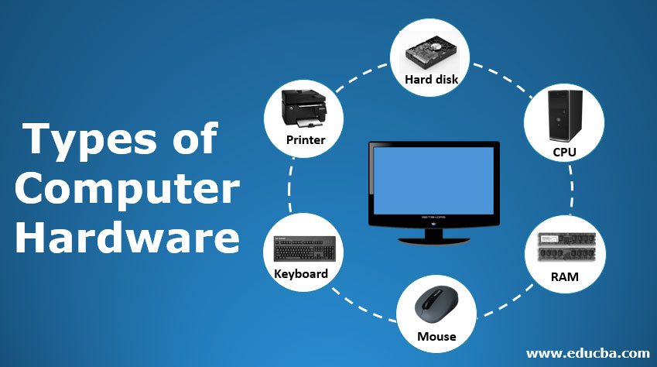

Slide 4

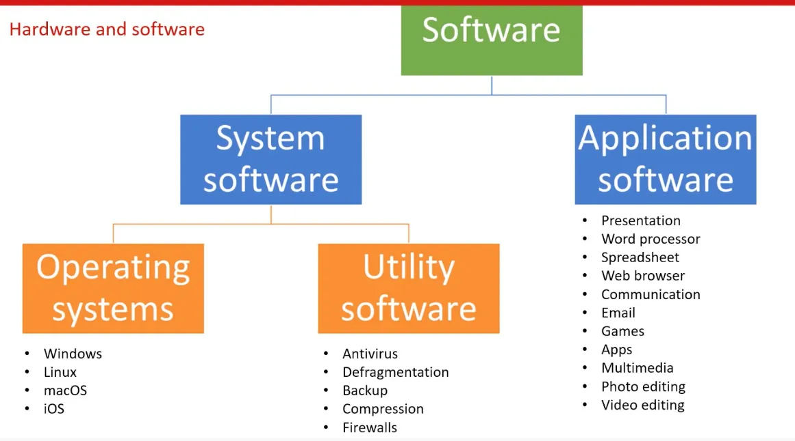

Slide 5
Operating System (OS):
An Operating System (OS) is software that manages the computer's hardware and software resources. It acts as an interface between the user and the computer, helping programs run and controlling the input and output devices. The OS ensures that the computer operates smoothly by managing memory, files, security, and other essential functions.

Slide 6
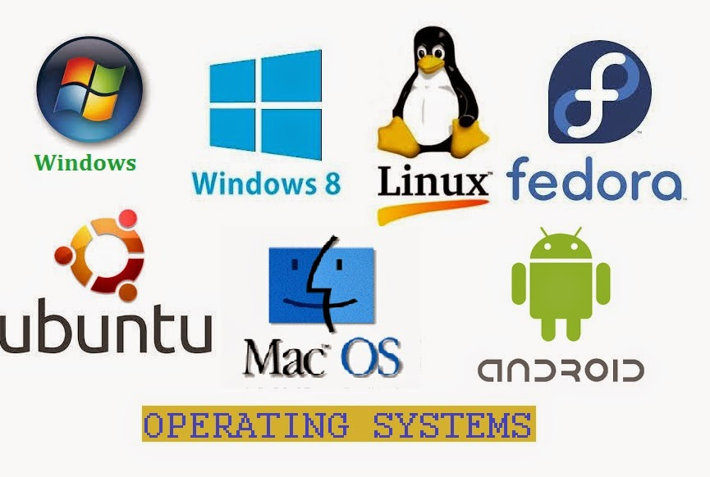
Types of Operating System (OS):

Slide 7
Installing Windows (Step-by-Step)
STEP(1) Preparation:-
Backup Important Data:
Save your important files to an external drive or cloud storage.
Have a Bootable USB or DVD with Windows:
Make sure you have a bootable USB drive or DVD with the Windows installation files.

Slide 8
Step 02:
Boot from Installation Media:
Restart the computer and enter BIOS/UEFI settings (usually by pressing F2, F12, or Delete during startup).
Set USB/DVD as the primary boot option in the boot menu.

Slide 9
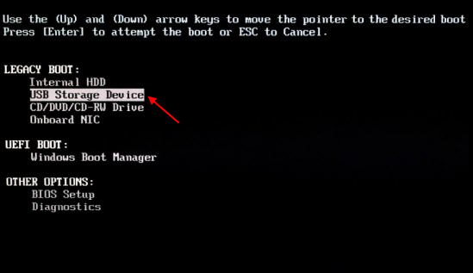
Boot menu:

Slide 10
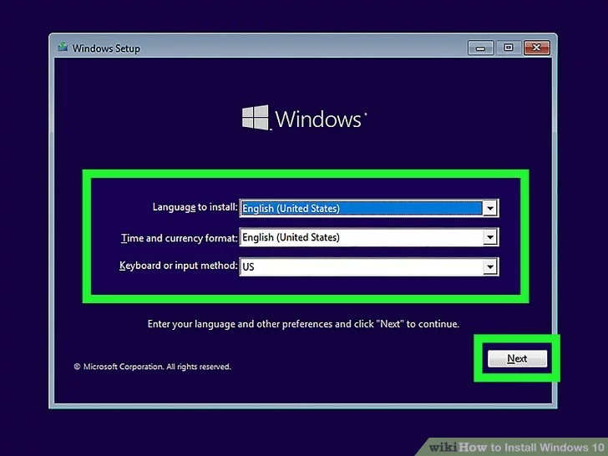
Step 03: Installation Process

Slide 11
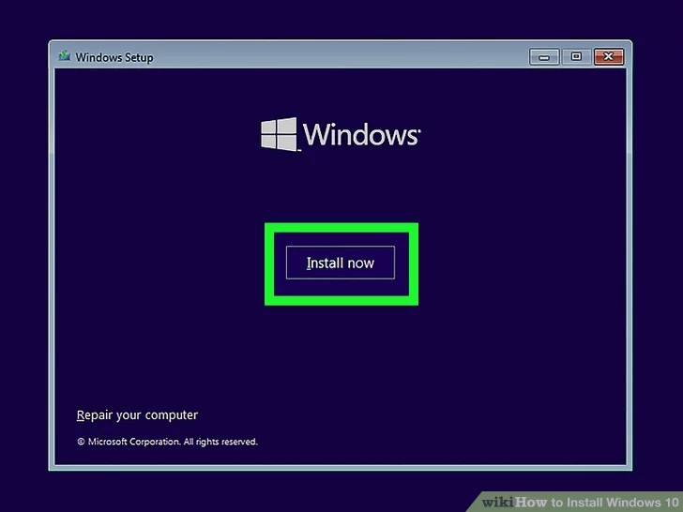

Slide 12
Step 04:
Next, select the version of windows you want, I suggest Windows 10 Pro, but you can select from the list what you prefer.

Slide 13
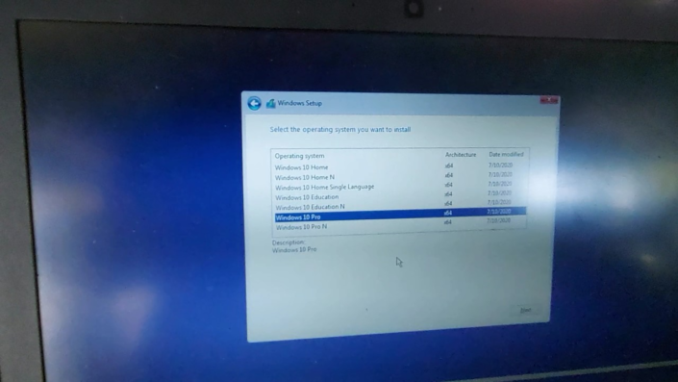

Slide 14
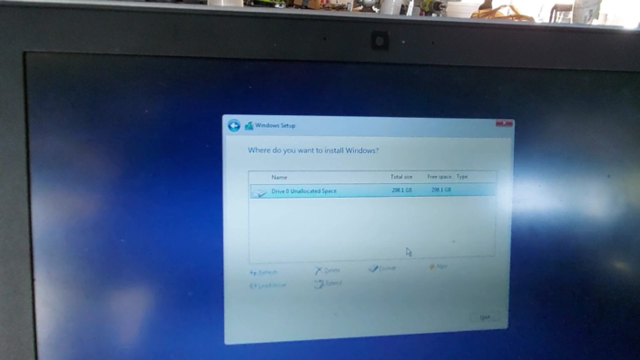
Step 05: selecting a drive

Slide 15
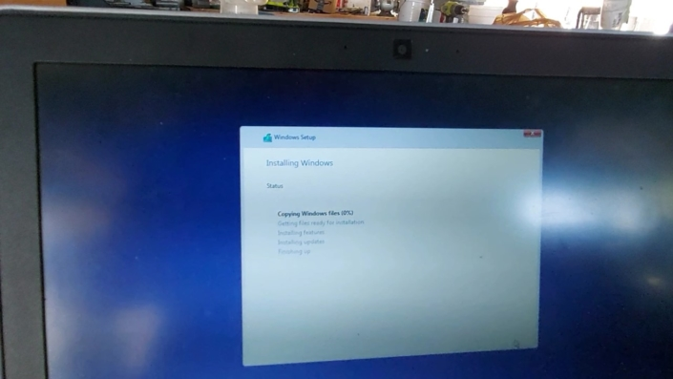
Step 06:

Slide 16
At this point windows should begin installing. Approximate installation time is 20 minutes.

Slide 17
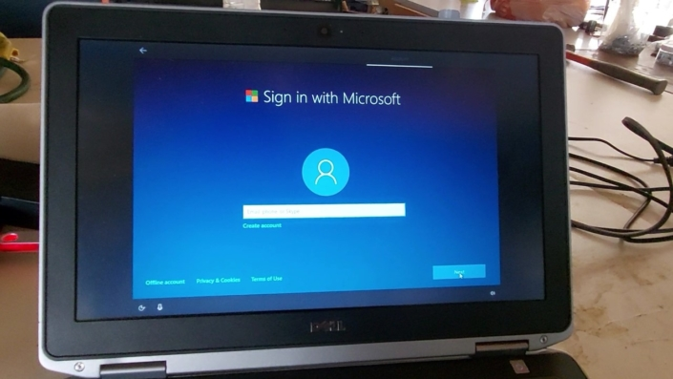
Step 07: Setting Up Your Laptop
After installation is complete it is time to set up the laptop.

Slide 18
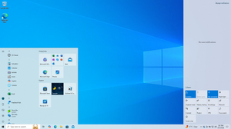
The installation of Windows is complete

Slide 19
Thank you for attention

